Slide 1

By: Jacob Villarreal ☺

Slide 2
Agenda
Overview of how DPAPI Works
Basic Encryption/Decryption Code
Dumping User’s Browser Credentials
Overview of SCCM’s NAA Credentials
Domain Persistence with Backupkey

Slide 3
HI
5 years in IT:
Offensive Security Consultant (Red, Purple, PenTest)
SysAdmin (Red Hat Linux and Windows Admin)
Help Desk
OSCP, CRTP
@VillaRoot (Twitter, YouTube)
https://www.linkedin.com/in/jacob-villarreal-utsa

Slide 4
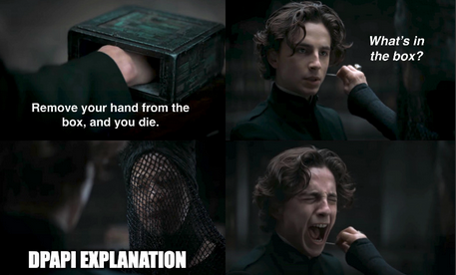
What Uses DPAPI?
Password Managers: Chrome, Edge, KeePass
Windows Credential Manager, Wifi Passwords, Outlook, Windows Vault
Remote Desktop Connection Manager (.rdg files)
OpenVPN
Many More

Slide 5
DPAPI Overview
Data Protection Application Programming Interface (DPAPI) – Built into Windows for ‘easy’ encryption.
It uses ProtectedData class which has two methods - Protect (encryption) and Unprotect (decryption).
When encrypting, a user can set the decryption to CurrentUser or LocalMachine:
CurrentUser: The protected data is associated with the current user. Only threads running under the current user context can unprotect the data.
LocalMachine: The protected data is associated with the machine context. Any process running on the computer can unprotect data.
These functions create a session key to perform the encryption. The session key is derived again when the data is to be decrypted.
DPAPI performs the cryptographic functions, the applications decide how to store the data
In AD environments, a ‘backup-key’ is stored on the Domain Controller.

Slide 6
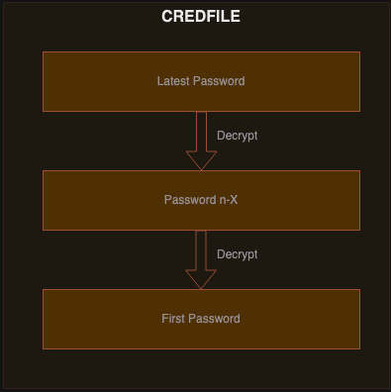
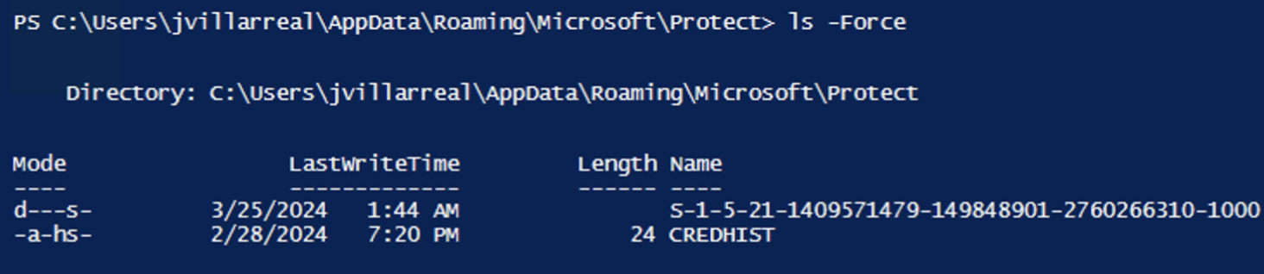
CREDFILE
CREDFILE is encrypted with the user’s current password
Stores history of user’s passwords in SHA1 and NTLM
When a new password is created, it is added at the top and is used to decrypt the hash below it
Located at %appdata%\Roaming\Microsoft\Protect
Sauce: https://learn.microsoft.com/en-us/previous-versions/ms995355(v=msdn.10)?redirectedfrom=MSDN

Slide 7
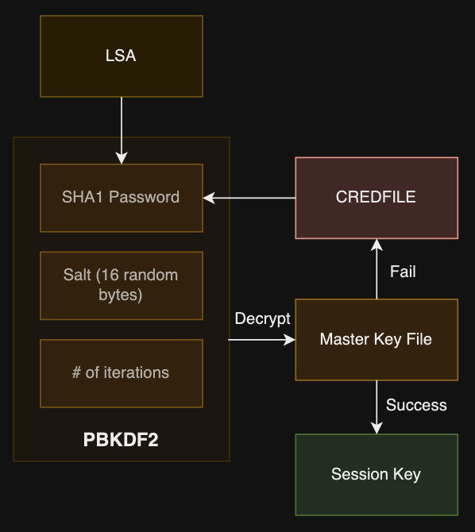
Master Key File
Each master Key has a GUID. The GUID is stored in the blob it encrypts, linking the blob to its Master Key
New Master Keys are generated every 3 months
User Master Keys are stored in %AppData%\Microsoft\Roaming\Protect\<sid>
System's Master Keys are stored in %WINDIR%/System32/Microsoft/Protect
Password-Based Key Derivation Function (PBKDF2) is used to protect the Master Key
If decryption fails with the current password, it will attempt to use the previous password in CREDFILE

Slide 8
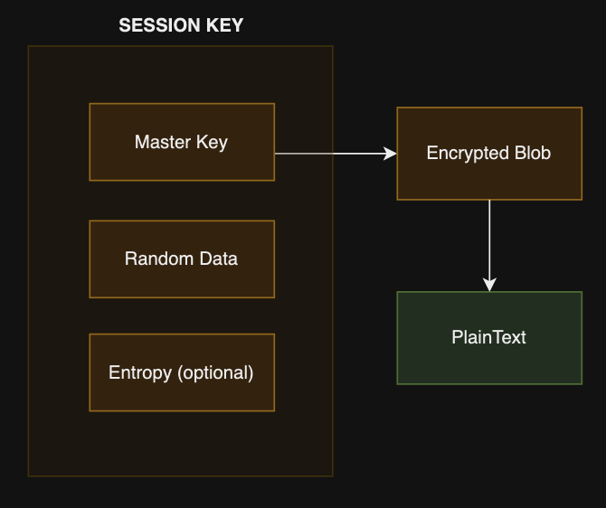
Session Key
The Session Key is what actually encrypts/decrypts the blob
Generated based on the MasterKey, some random data, and additional entropy (optional)
Random data is stored in blob
Session keys are never stored, DPAPI only stores the random data it used inside the BLOB. Which is needed for decryption

Slide 9
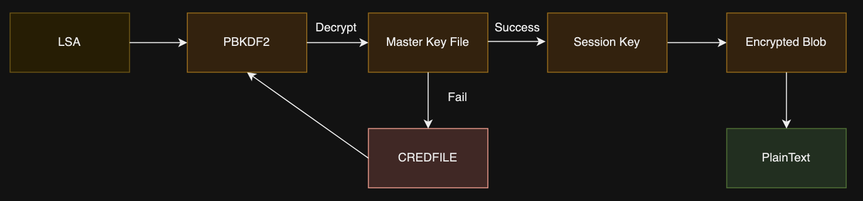
Full Process
Notes:
https://learn.microsoft.com/en-us/previous-versions/ms995355(v=msdn.10)?redirectedfrom=MSDN

Slide 10
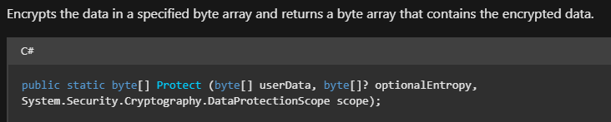
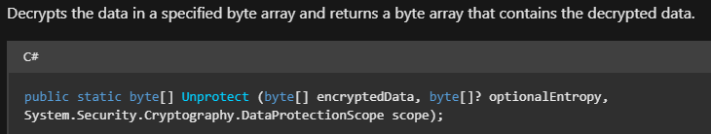
Boring Syntax
Protect – Encrypts data
UnProtect – Decrypts data
userData - byte array that contains data to encrypt.
encryptedData - A byte array containing data encrypted
optionalEntropy – like a ‘password’ needed to decrypt blob, can be set to null
scope – specifies the scope of encryption:
Local_Machine - Use local machine instead of current user
Current User – Uses current user
Sauce: https://learn.microsoft.com/en-us/dotnet/api/system.security.cryptography.protecteddata?view=net-8.0

Slide 11
C# Encrypt/Decrypt
Encrypt:
byte[] secret = { 1, 4, 5, 6 }; //data to encrypt
byte[] encryptedSecret = ProtectedData.Protect(secret, null, DataProtectionScope.CurrentUser);
Decrypt:
byte[] originalData = ProtectedData.Unprotect(encryptedSecret, null, DataProtectionScope.CurrentUser);
Notes:
Demo

Slide 12
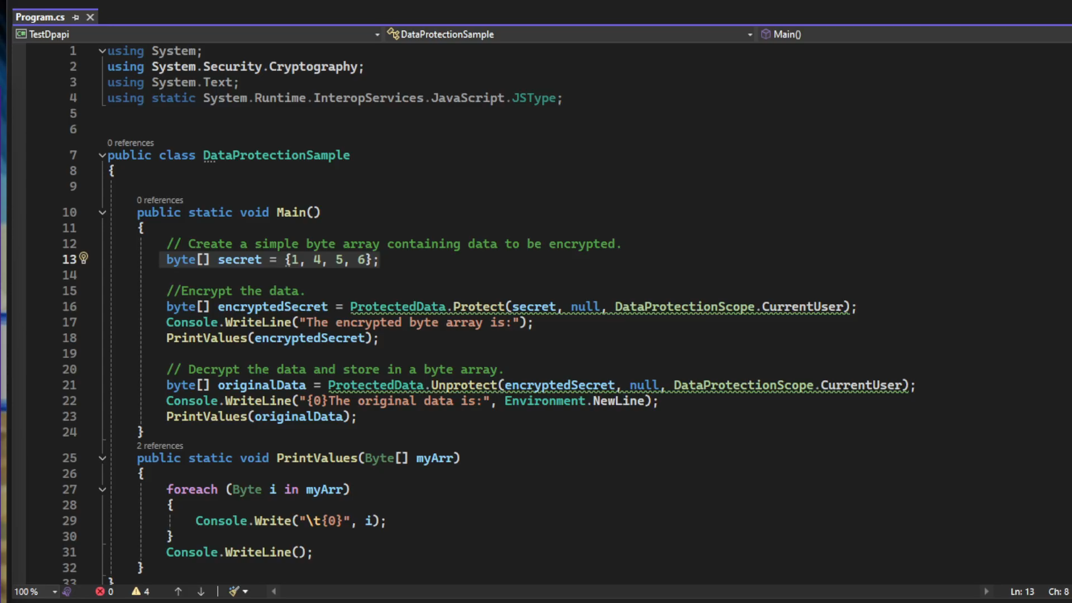
C# Encrypt/Decrypt (Demo)
Notes:
Demo

Slide 13
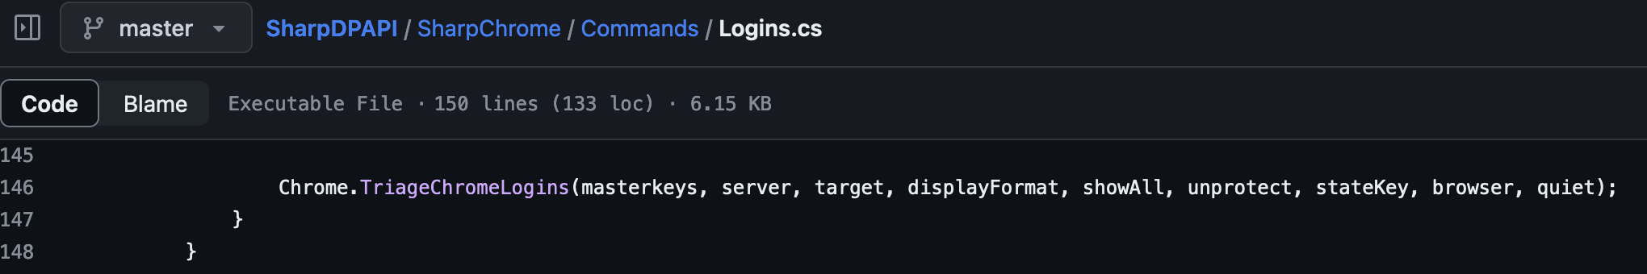
SharpChrome
Will decrypt blobs from chromium-based browsers (Chrome, Edge, Brave) to retrieving login credentials and cookies from current users
‘Login State’ file contains a ‘Key’ to decrypt the ‘Login Data’ and ‘Cookies’ files
Needs SQLite to extract info from decoded files

Slide 14
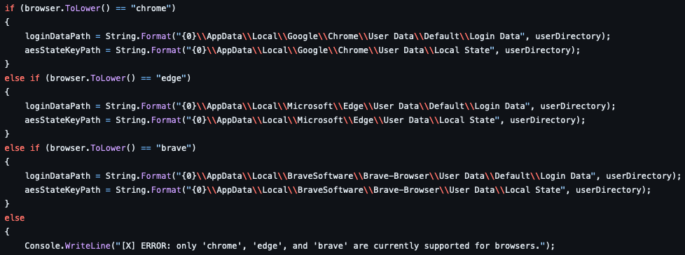
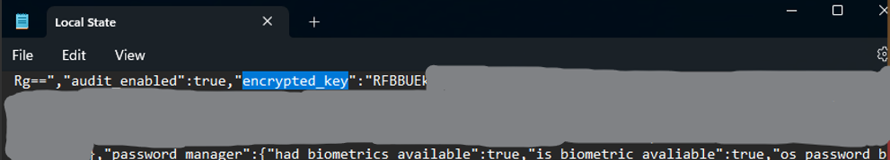
SharpChrome Code

Slide 15
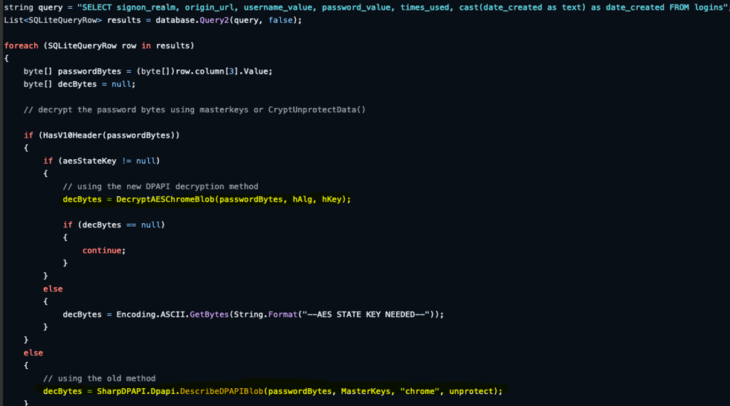
SharpChrome Code

Slide 16
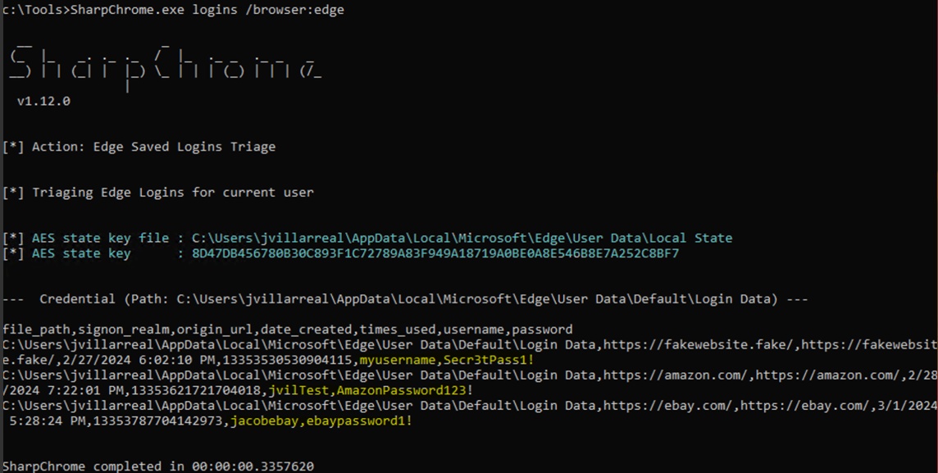
SharpChrome Execution
SharpChrome: https://github.com/GhostPack/SharpDPAPI
Notes:
Demo

Slide 17
SCCM Network Access Account (NAA)
System Center Configuration Manager (SCCM) uses an NAA to allow non-domain computers to retrieve software
One of the first policies received is the NAA.
The policy is stored in the WMI Namespace ‘root\ccm\policy\Machine\ActualConfig’ in the class ‘CCM_NetworkAccessAccount’ and can queried with the following PowerShell command:
Get-Wmiobject -namespace ‘root\ccm\policy\Machine\ActualConfig’ -class ‘CCM_NetworkAccessAccount’
Need local admin on the machine to decrypt, then can use ‘SharpDPAPI.exe SCCM’
Sauce: https://posts.specterops.io/the-phantom-credentials-of-sccm-why-the-naa-wont-die-332ac7aa1ab9

Slide 18
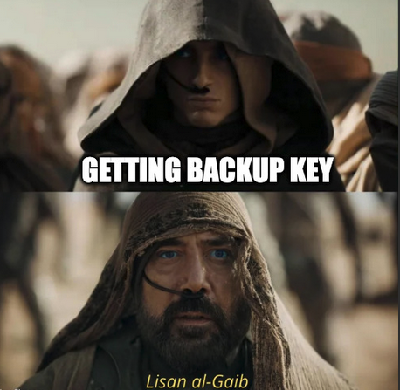

Domain Backup Key
If Help Desk changes a user’s password, CREDFILE doesn’t get updated
Domain Controllers have a backupkey that can be used as a fail safe for decryption. Only Domain Admins can access.
It is randomly generated when the domain is created, and CAN NOT be changed.
Recommendation from Microsoft in case of Backup Key compromise is to… create new domain and migrate users to it lol
SharpDPAPI and MimiKatz are commonly used to extract backup keys
Sauce: https://learn.microsoft.com/en-us/windows/win32/seccng/cng-dpapi-backup-keys-on-ad-domain-controllers

Slide 19
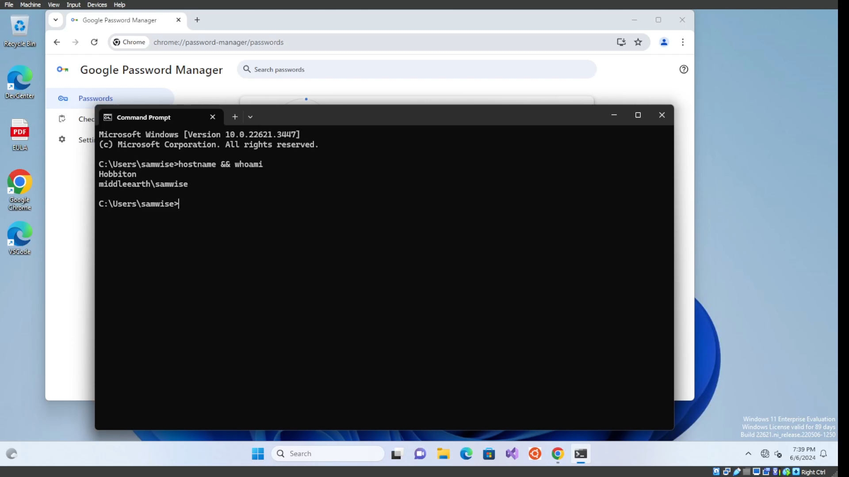
Backup Key (Demo)
Notes:
How you find me

Slide 20

@VillaRoot (Twitter, YouTube)
https://www.linkedin.com/in/jacob-villarreal-utsa
Notes:
Demo

